Slide 1
Big Data, Data Streaming and Mobile Cloud
Session 12
Course : COSC6100001 - Cloud Infrastructure
D6825 - Samuel Philip

Slide 2
Learning outcomes
(C4) Analysis : identify problems that can be solved using cloud global infrastructure
(C2) Comprehension : group Classify real-worlds problems in accordance with cloud computing infrastructure
(C4) Analysis : analyze identifying problems and choose proper Cloud Services and Cloud Infrastructure
(C5) Synthesis : design Cloud computing architecture and infrastructure and implementation on applciations

Slide 3
Outline
Big Data
Data Warehouse
Data Streaming
Mobile Computing and Applications

Slide 4
Big Data

Slide 5
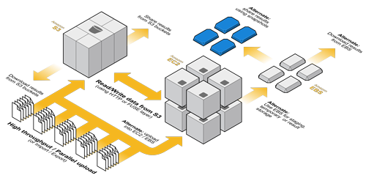
Big data
There are three characteristics of Big Data called “Vs”: volume, velocity, and variety, along with persistency.
Volume is self-explanatory, and velocity means that responses to queries and data analysis requests have to be provided very fast. Variety recognizes the wide range of data sources and data formats. Persistency means that data has a lasting value; it is not ephemeral.
Big Data covers a wide spectrum of data including user-generated content and machine-generated data.
It’s hit or miss in terms of quality and/or structure, some are structured, some raw data

Slide 6
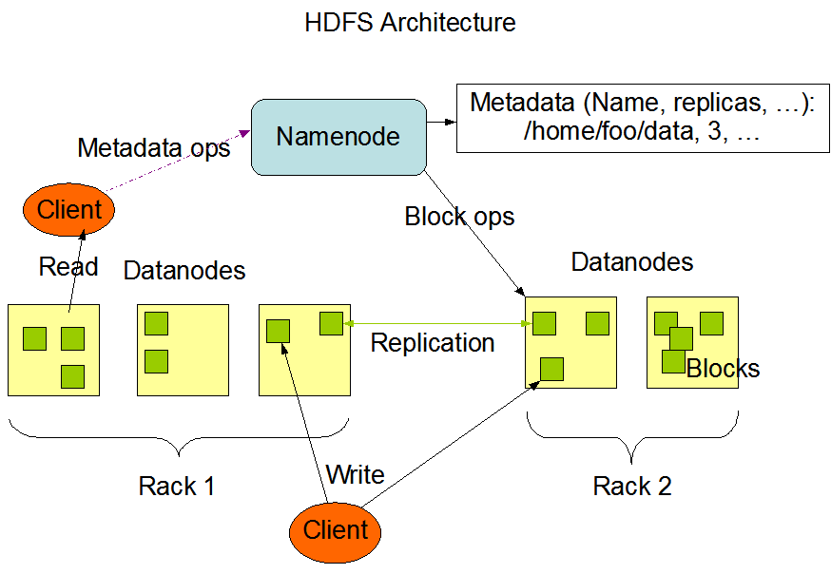
Big data
Common traits
Data is immutable; consequently, widely used storage systems for Big Data such as HDFS only allow append operations
Jobs such as MapReduce are deterministic; therefore fault tolerance can be ensured by recomputations.
The same operations are carried out on different segments of data on different servers; replicating programs is less expensive than replicating data.
It is feasible to identify a working set, a subset of data frequently used within a time window and keep this working set in the memory of the servers of a large cluster. Systems such as Spark and Tachyon exploit this idea to dramatically improve performance.
Locality, the proximity of the data to the location where it is processed is critical for the performance. Supporting data locality is a main objective of scheduling algorithms, including delay scheduling and data-aware scheduling.

Slide 7
Big data
challenges
Develop a scalable data infrastructures capable to respond promptly to the timing constraints of an application.
Develop effective means to accommodate diversity in data management systems.
Support comprehensive end-to-end processing and knowledge extraction from data.
Develop convenient interfaces for a layman involved in data collection and data analysis.

Slide 8
Data Warehouse

Slide 9
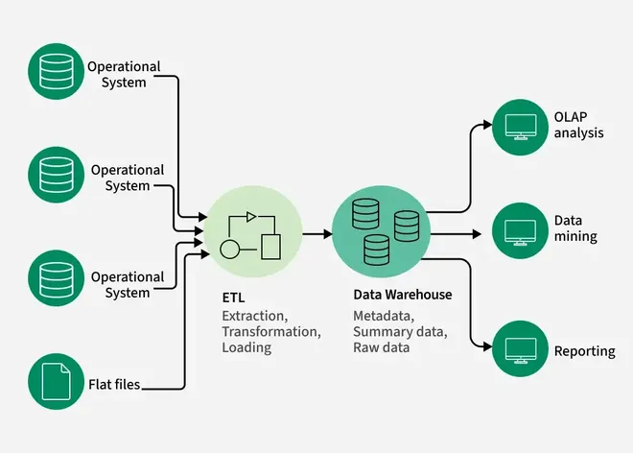
Data Warehouse
A data warehouse is a central repository for the important data of an enterprise
a core enterprise software component required by a range of applications related to so-called business intelligence.
Data from multiple operational systems are uploaded and used for predictive analysis and for the detection of hidden patterns in the data.
Data models developed using Statistical Learning Theory allow enterprises to optimize their operations and maximize their profits.

Slide 10
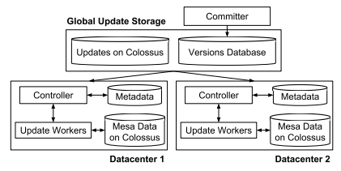
Data warehouse
mesa
Mesa is a scalable data warehouse that developed at Google
it designed to support measurement data for the multibillion-dollar advertising business of the organization.
The system is expected to support near-real-time data processing and be highly available and scalable. The extremely high availability is ensured by geo-replication.
Mesa is able to handle petabytes of data, respond to billions of queries accessing trillions of rows of data per day, and update millions of rows per second.

Slide 11
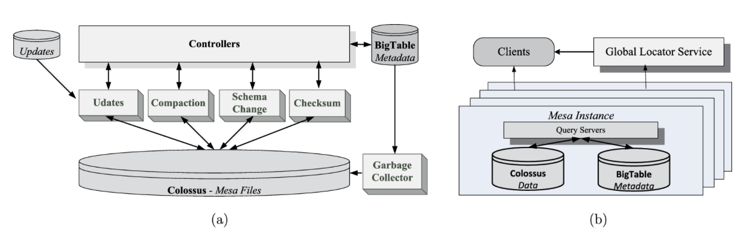
Data warehouse
Mesa instance
The controller/worker subsystem. Controllers interact with four types of workers: update, compaction, schema change, and checksum. The data and metadata are stored on Colossus and BigTable, respectively.
The query subsystem of a Mesa instance interacts with the clients and with the Global Location Service.
One Mesa instance runs at every site and consists of two subsystems, the update/maintenance and the query subsystem. The pool of workers of the first subsystem operate on data stored in Colossus. Workers load updates, carry out table compaction, apply schema changes, and run table checksums under supervision of controllers that determine the work to be done and manage metadata stored on BigTable.

Slide 12

Spanner
Spanner is a distributed database replicating data on many sites across the globe.
Some applications replicate their data across three to five data centers running Spanner in one geographic area. Other applications spread their data over a much larger area
The data model of each application using Spanner is layered on top of the directory-bucketed key-value mappings supported by the distributed database.
Spanner supports consistent backups, atomic schema updates, and consistent MapReduce execution and provides externally consistent reads and writes and globally consistent reads across the database at a time stamp.

Slide 13
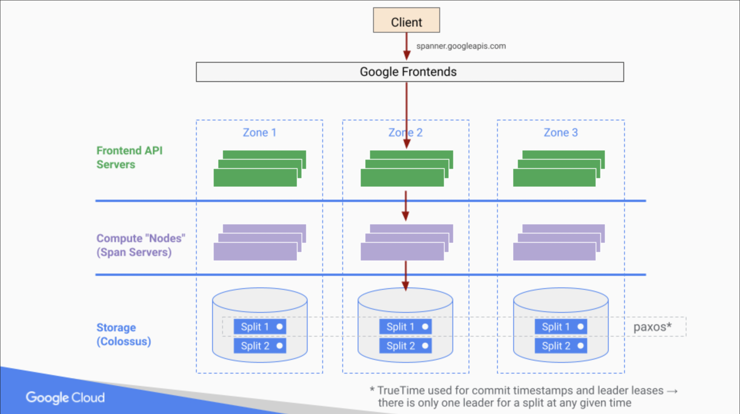
spanner
Spanner applications can control the number and the location of data centers where the replicas reside, as well as read and write latency. The read and write latencies are determined by how far data is from its users and, respectively, how far are the replicas from one another. The system is organized in zones, units of administrative deployment and of physical isolation similar with AWS zones.
The database supports read-write transactions, read-only transactions, and snapshot reads.
Notes:
A read–write transaction implements a standalone write, and the concurrency control is pessimistic.
A read-only transaction benefits from snapshot isolation.
A snapshot read is a lock-free read in the past, at a time stamp specified by the client or at a time stamp chosen by the system before a time stamp upper bound specified by the client.

Slide 14
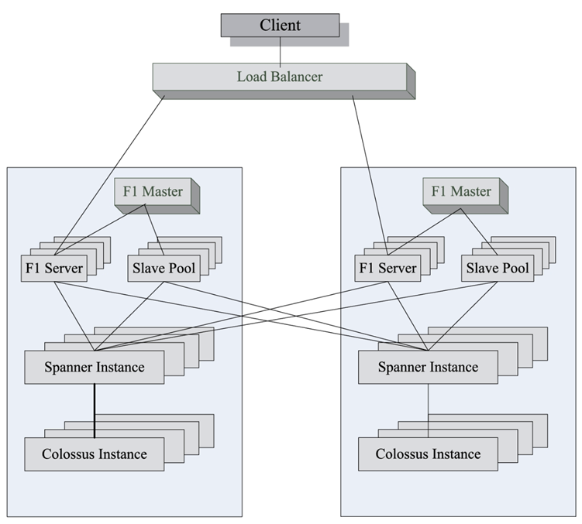
F1-scaling
F1-scaling is a traditional database design shares the goals with the design of data warehouses,
F1 has a logical Relational Database Management System schema with some extensions, including explicit table hierarchy and columns with Protocol Buffer data types.
F1 stores each child table clustered with, and interleaved within, the rows from its parent table. Table columns contain structured data types based on the schema and binary encoding format of Google's open-source Protocol Buffer library.

Slide 15
Mesa-spanner-F1 scaling
How it works, google Ads example
F1 Query: It can run a single SQL query that joins data living in Spanner (like customer names) with data living in Mesa (like their click performance).
Continuous Updates: As transactions happen in F1/Spanner, they are often exported or streamed into Mesa so the "analytical" side of the house stays in sync with the "transactional" side.
Data Consistency: Mesa uses a versioning system. When you query Mesa, it gives you a "consistent snapshot" of the data at a specific point in time, matching the state of the business logic in F1.

Slide 16
Data Streaming

Slide 17
Data streaming
Data streaming is the transfer of data at a steady high-speed rate, with low and well-controlled latency. The data volume in data streaming is high and decisions have to be made in real-time. High-definition television (HDTV) is a ubiquitous application of data streaming.
Cloud data streaming services support content distribution from many organizations, e.g., AWS hosts Netflix and Google cloud hosts YouTube.
Clouds support a variety of other data streaming applications in addition to hosting content providers. For example, AWS supports several streaming data platforms, including Apache Kafka, Apache Flume, Apache Spark Streaming, and Apache Storm.

Slide 18
Data Streaming versus Batch Processing
Streaming processes individual records or microbatches, rather than large batches.
Streaming processes only the most recent data or data over a rolling time window, rather than the entire, or a large segment of a, data set.
Streaming requires latency of milliseconds, rather than minutes or hours.
Streaming provides simple response functions, aggregates, and rolling metrics, rather than carrying out complex analytics.
It can be hard to reason about the global state in data streaming because different nodes may be processing data that arrived at different times, while in batch processing the system state is well defined and can be used to checkpoint and later restart the computation.

Slide 19
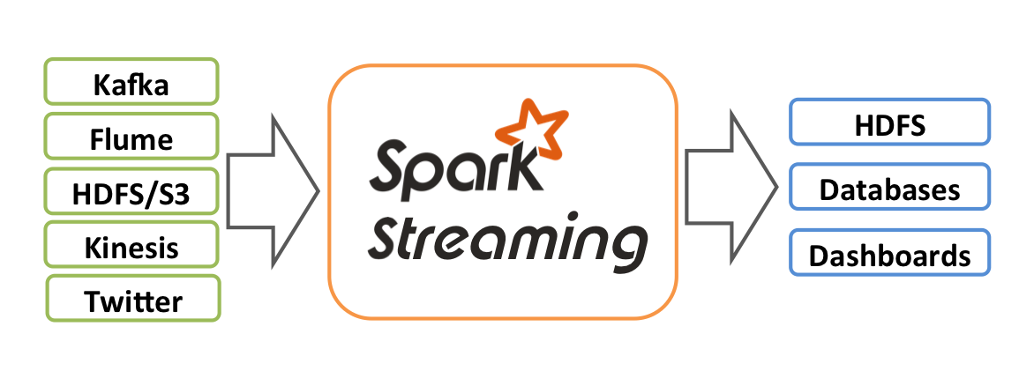
Spark streaming
Spark Streaming system along with a data streaming model, called D-Streams.
D-Streams model offers a high-level functional programming API, strong consistency, and efficient fault recovery. This model, prototyped as Spark Streaming, achieves fault tolerance by replication; there are two processing nodes, the upstream backup and a downstream node.
To address the latency concerns, the Spark Streaming system relies on a storage abstraction, Resilient Distributed Dataset (RDD), to rebuild lost data without replication
Notes:
Spark Streaming system along with a data streaming model, called D-Streams. D-Streams model offers a high-level functional programming API, strong consistency, and efficient fault recovery. This model, prototyped as Spark Streaming, achieves fault tolerance by replication; there are two processing nodes, the upstream backup and a downstream node.
To address the latency concerns, the Spark Streaming system relies on a storage abstraction, Resilient Distributed Dataset (RDD), to rebuild lost data without replication. A parallel recovery mechanism involve all cluster nodes working in concert to reconstruct lost data.
Spark Streaming provides an API similar to DryadLINQ in the Scala language and supports stateless operations acting independently in each time interval, as well as aggregation over time window.
To recover in the case of node failures, D-Streams and RDDs track their lineage using a dependency graph.

Slide 20
Spark streaming
System support
Stateless transformations available in batch frameworks, such as map, reduce, groupBy, and join, and provides two types of operators: (i) stateless and statefull transform operators, the first act independently on each time interval and the second share data among intervals; and (ii) output operators that save data, e.g., store RDDs on HDFS.
New statefull operations: (i) windowing - a window groups records from a range of past intervals into one RDD; (ii) incremental aggregation over a window; and (iii) time-skewed joins when a stream is combined with RDDs.
Notes:
Spark Streaming system along with a data streaming model, called D-Streams. D-Streams model offers a high-level functional programming API, strong consistency, and efficient fault recovery. This model, prototyped as Spark Streaming, achieves fault tolerance by replication; there are two processing nodes, the upstream backup and a downstream node.
To address the latency concerns, the Spark Streaming system relies on a storage abstraction, Resilient Distributed Dataset (RDD), to rebuild lost data without replication. A parallel recovery mechanism involve all cluster nodes working in concert to reconstruct lost data.
Spark Streaming provides an API similar to DryadLINQ in the Scala language and supports stateless operations acting independently in each time interval, as well as aggregation over time window.
To recover in the case of node failures, D-Streams and RDDs track their lineage using a dependency graph.

Slide 21
Caching Strategies for Data Streaming
Routers of a Content-Centric Network (CCN)—use several replacement policies,
LRU (Least Recently Used) keeps in cache the most recently used content,
LFU (Least Frequently Used) uses cache request history to keep in cache highly used content,
sLRFU (streaming Least Recently/Frequently Used) aims to maximize cache and support tradeoffs by specifying a weight for each request that decays exponentially over time.

Slide 22
Mobile Computing and Applications

Slide 23
Mobile Devices in The Cloud Ecosystem
Mobile cloud computing (MCC) is the method of using cloud technology to deliver mobile apps.
Mobile devices capture images and videos rich in content, rather than simple scalar data such as temperatures.
There is power in numbers—cloud sourcing amplifies the power of sensing and can be used for applications related to security, rapid service discovery, etc.

Slide 24
Application of mobile computing
There are countless examples of such ubiquitous applications of mobile cloud computing in areas as diverse as health care, learning, electronic commerce, mobile gaming, mobile location services, and search.
  An important application of mobile healthcare is patient record storage and retrieval and medical image sharing using computer clouds and mobile devices.
  There are many education tools helping students learn and understand subjects as diverse as anatomy, computer science, or engineering, or the arts.
  Mobile gaming has the potential of generating large earnings for cloud service providers.

Slide 25
The Future of Mobile Cloud Computing
As the technology advances, mobile devices will be equipped with more advanced functional units, including high-resolution cameras, barometers, light sensors, etc.
Augmented reality and mobile gaming are emerging as important mobile cloud computing applications.
Augmented reality could become a reality with new mobile devices and fast access to computer clouds.
Composition of real-time traffic maps from collective traffic data sensing, monitoring environmental pollution, and traffic and pollution management in smart cities are only a few of the potential future applications of mobile cloud computing.

Slide 26
Mobile Cloud Computing Future Solutions
Code and computation offloading—currently based on static partitioning and dynamic profiling is expected to be automated in the future.
Task-oriented mobile services—currently provided by Mobile-Data-as-a-Service, Mobile- Computing-as-a-Service, Mobile-Multimedia-as-a-Service, and Location-based Services—are expected to be replaced by human-centric mobile services.
Elasticity and scalability—components of the resource allocation and scheduling are expected to be validated by algorithms using valid traffic VM migration models.
Cloud service pricing—currently based on auctions, and bidding is expected to be replaced by empirical validation and optimization algorithms.

Slide 27
Exercise
Find example of data warehouse implementation case other than the google adwords, find and explain why it works, why, what is the benefits of using it

Slide 28
References
Marinescu, Dan C. (2022). Cloud Computing Theory and Practice: 3rd Edition. Morgan Kaufmann Publishers. ISBN: 978-0-323-85277-7
https://docs.cloud.google.com/spanner/docs/whitepapers/life-of-reads-and-writes#:~:text=This%20allows%20different%20Spanner%20machines,order%20to%20make%20TrueTime%20work.
https://static.googleusercontent.com/media/research.google.com/en//pubs/archive/42851.pdf
https://spark.apache.org/docs/latest/streaming-programming-guide.html

Slide 29
Thankyou

